Slide 1

Async functions and Promises in UI5/node.js
Notes:
Datum: 25-02-2019
Owner: Corp Comms
Info NL: Andere afbeeldingen voor deze tussenslide zijn te vinden op Connect via de volgende link: https://connect.ordina.nl/WieWatWaar/CentraleAfdelingen/CC/Pages/default.aspx
in het bestand: Cover slides.pptx

Slide 2
Async functions and Promises in UI5/node.js
Content
What are Async functions and Promises
What are the benefits
Demo / Live coding / Theory
Questions
Notes:
Datum: 25-02-2019
Owner: Corp Comms
Standaard slide

Slide 3
Async functions and Promises in UI5/node.js
getAllSerial = async function () {
var sOne = await this.getNumber(1);
var sTwo = await this.getNumber(2);
return sOne + sTwo;
};
getAllParalel = async function() {
var sOne = this.getNumber(1);
var sTwo = this.getNumber(2);
return(await sOne + await sTwo);
};
getNumber = function(n) {
var that = this;
return new Promise(function(resolve, reject){
setTimeout(function(){
resolve(n);
},2000);
});
};
Notes:
Datum: 25-02-2019
Owner: Corp Comms

Slide 4
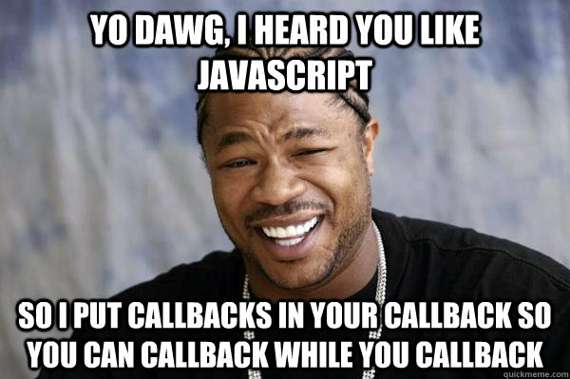
Async functions and Promises in UI5/node.js
The benefits
Better readable, due to the natural order
Promise objects are heavily used in modern techniques like PWA
Promise object describe a standard
Notes:
Datum: 25-02-2019
Owner: Corp Comms
Standaard slide

Slide 5
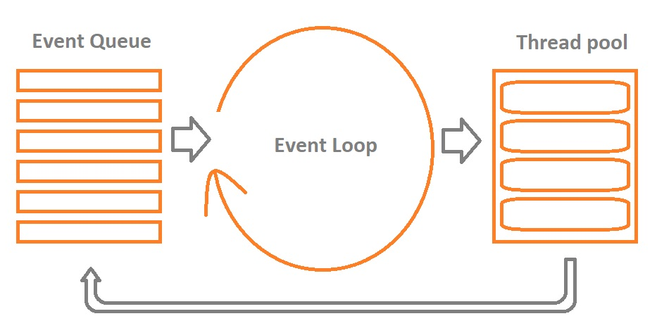
Async functions and Promises in UI5/node.js
JavaScript Event Loop
Notes:
Datum: 25-02-2019
Owner: Corp Comms
Standaard slide

Slide 6
Async functions and Promises in UI5/node.js
Lessons learned
How async functions and promises look like in code
How to Prepare the WebIDE
How the js event loop works
The fact that I can use ‘Copy as fetch’ in the chrome debugger
The fact that I can store a resolve or reject function for later use
How then-chaining works
How Try and catch work
Examples of promise objects that are widely available
Possibilities with Promise.race and Promise.all
The necessity of abort Controllers and signals
Notes:
Datum: 25-02-2019
Owner: Corp Comms
Standaard slide

Slide 7
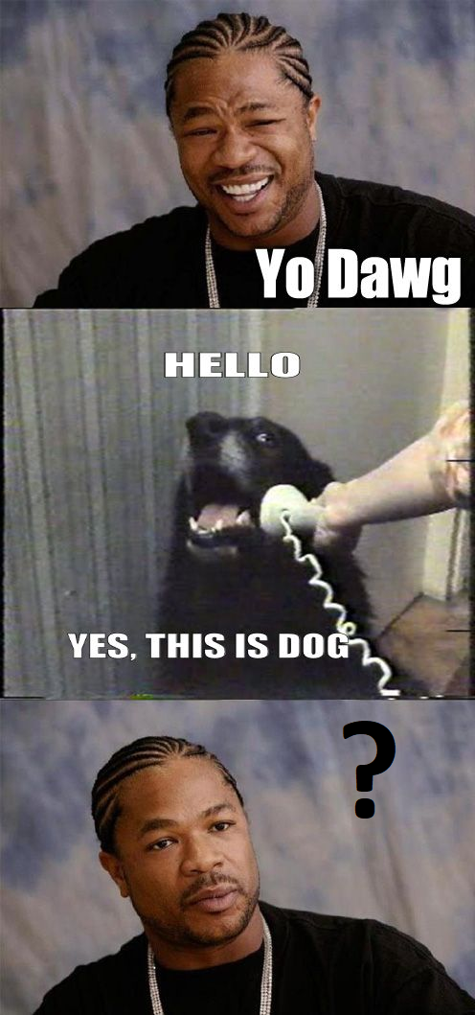



Async functions and Promises in UI5/node.js
On tour
Notes:
Datum: 25-02-2019
Owner: Corp Comms
Standaard slide

